Slide 1
Company Formation In India/ How a factory can be established

Slide 2
Types of Business Structures In India
One Person Company (OPC)
Limited Liability Partnership (LLP)
Private Limited Company (PLC)
Public Limited Company (PLC)
It is important to choose the business structure carefully as Income Tax Returns will depend on it.
Each business structure has different levels of compliances that need to be met with. For example, a sole proprietor has to file only an income tax return. However, a company has to file an income tax return as well as annual returns with the registrar of companies.
Other forms of business structures include Sole proprietorship, Hindu Undivided Family, and Partnership firms. These structures do not come under the ambit of company law.

Slide 3
How to choose a business structure while applying for company registration in India?
Every entrepreneur must ask himself before he/she finally decide upon a business structure.
How many owners/partners will the business have?
Should the initial investment determine the choice of business structure?
Willingness to bear the entire liability of the business
Income Tax Rates Applicable to businesses
Plans of getting money from investors

Slide 4
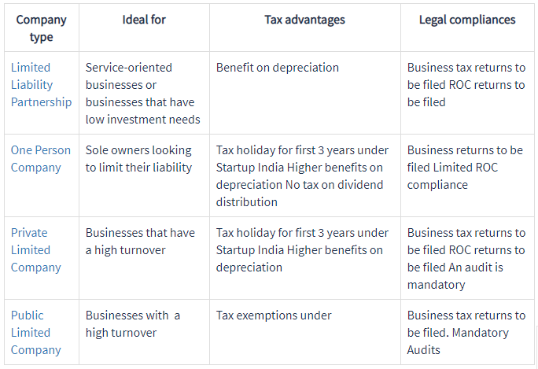
How to choose a business structure while applying for company registration in India?

Slide 5
How to Register a Company in India?
Registering a company in India is now a simple 4-step process.
Here is what you’ll need to acquire:
A Digital Signature Certificate(DSC)
A Director Identification Number (DIN)
Registration on the MCA Portal or New user registration
Certificate of Incorporation

Slide 6
Requirement for a private Limited Company
The basic Requirement for a private Limited Company in India is as follows:-
Minimum Two Directors of The company
Minimum Two Shareholders of the Company
Minimum Capital of the Company should be INR 100000/-

Slide 7
How long does the appropriate registration of the previous suggested legal entity take?
Activity | Days
Taking Directors Identification Number (DIN) | 1 Day
Taking Digital Signature of Directors | 1 Day
Reservation of the name of the Company | 5 Days
Preparation of other Document such as Memorandum of Association ( MOA), Articles of Association(AOA), Forms etc | 2 Days
Filling of Documents with Authorities | 1 Days
Liaison with the authorities and Correction | 3 Days
Getting Final Certificate of Incorporation | 2 Days
Total Number of Days | 15 Days

Slide 8
Formation Cost involved in the formation of the Above Company (For capital of INR 1 Lakh)?
Activity | Days
Taking Directors Identification Number (DIN) | INR 1500/- Each Director *2
Taking Digital Signature of Directors | INR 5000/- Each Director*2
Reservation of the name of the Company | INR 1000/-
Filling fees of government for final documents* | INR 6200/-
Other Government Expenses | INR 3000/-
Total Cost | INR 23200/-
* Fees Changes with the amount of Capital of Company

Slide 9
Income Tax returns depends on the type of business structure? True / False

Slide 10
To registering a company in India the person need to acquire the following:
Digital Signature Certificate(DSC)
Director Identification Number (DIN)
Registration on the MCA Portal
Certificate of Incorporation
All of the above

Slide 11
Operating principles/ Legal requirements/ Accounting requirements of a foreign company operating in India
Subsidiary of Foreign Company need to take RBI Approval for investment made in India.
Company need to Maintain its books of Accounts.
Company need to get its accounts audited every year.
Company need to file its tax returns.
Company need to file annual account with authorities.
Income tax rates applicable to Companies @30%.
Company need to have various Business registration with authorities like PAN, TAN, GST etc depending on the applicability.
Regular Monthly/Quarterly/Six Monthly Return shall be filled for above registration as per applicability.

Slide 12
Process on getting investment capital into the country… What are the pitfalls of this?
Investment in India is governed by the Foreign Direct Investment Guidelines, Mainly the investment in India is allowed under two Method : Investment through Prior Approval : In certain nature of business the prior approval is required from the government of India and once the approval is received than the investment can be made in the Indian Company. Investment under Automatic Route : Most of the Business are allowed to invest under automatic route, Under automatic route the company can invest in Indian Company without prior approval. Once the capital is remitted in the Indian Company within 180 days of the introduction of capital the company has to carry out all the necessary document filling with the RBI. Following are the documents.
Filling intimation of receipt of Share Capital (within 30 Days)
Filling the form related to RBI with share allotment details and other information
Filling Legal Compliance certificate from Company Secretary.
Filling share valuation certificate from the Chartered Accountant.

Slide 13
Can another company be sole share holder & director of a Private Limited Company?
As per the Basic requirement for the Company formation we need minimum 2 Shareholders and 2 Directors. Hence we need minimum two shareholders and directors.
In order to fulfill your requirement we can form Company by giving just one share to the second shareholders. The second shareholder will hold the shares on behalf of the Company itself hence the ownership will be 100% with the Company.
In respect of the directorship we need minimum two individual name to be acting as directors of the Company.

Slide 14
Do the directors need to be present in person in India to perform the formation?
No, the directors need not be present to perform the formation of the Company, They can provide the documents through the courier to the office.
Following are the documents which needs certification.
Passport of the directors – Duly Notarised
Proof of the Residential address of Directors – Duly Notarised
Documents mentioning the father’s name of the directors. (Birth Certificate)
Declaration of subscription of shares in the own handwriting of the shareholders or person authorised by Company. – Certified by Indian Consulate
Resolution by the investor Company mentioning about investment in India and authorising any person to sign all documents on the investors behalf.
The above documents shall be duly notarised or certified by Indian Embassy in their country.

Slide 15
License For Factory Setup In India/ related laws, required licenses, steps involved in acquiring the license
SSI (Small Scale Industry)/ MSME(Micro Small Medium Enterprise)/ DIC(District Industry Centre) Registration
Every business registered in India is provided certain benefits by the government of India based on its classification in the type of entity it is i.e Small, Medium or Micro. When you register a Micro, Small and Medium Enterprise, you will get an MSME certificate (provisional or permanent).
This MSME certificate helps you enjoy various benefits like priority sector lending (you get loans easily), differential rates of interest (you pay lesser interest on loans), various exemption under tax laws, get environmental clearances, etc
When you are about to start your Micro, Small and Medium Enterprise, you should apply for a Provisional Registration.
Once you are given the Provisional MSME Certificate and you start production you can apply for a Permanent Certificate, which opens up more benefits for you.

Slide 16
Provisional Registration
Provisional registration is granted to a unit at its pre- investment period to enable it to take necessary steps to apply for financial credit, land or an industrial set, water, power or telephone connections, etc.
Permanent / Final Registration
A provisionally registered industrial unit when it is about to go into production is to apply for grant of Permanent / Final Registration. An existing and functioning industrial unit is eligible to apply for Permanent / Final Registration without going into provisional registration processes.

Slide 17
Permanent / Final Registration
No. | Type of Enterprise | Manufacturing Industry (Investment in Plant and Machinery) | Service Industry (Investment in Equipments)
1 | Micro | Does not exceed Rs. 25 Lakh | Does not exceed Rs. 10 Lakh
2 | Small | Exceeds Rs. 25 Lakh but does not exceed Rs. 5 Crore | Exceeds Rs. 10 Lakh but does not exceed Rs. 2 Crore
3 | Medium | Exceeds Rs. 5 Crore but does not exceed Rs. 10 Crore | Exceeds Rs. 2 Crore but does not exceed Rs. 5 Crore

Slide 18
Pollution Control Board Consent (PCB Consent)
Setting up a manufacturing unit in India attracts many types of licenses from Indian Government i.e both State and Central, One of such license is for the Pollution Licenses.
Any industry, which discharge sewage or effluent into the environment or emit any pollution in air will have to obtain consent of the State Pollution Control Board.
Similarly any industry / process generating, storing, transporting, disposing or handling hazardous waste are required to obtain authorization from MPC Board.
There are two types of consent
Consent to Establish
All the industries and activities needing consent must obtain consent to establish before actual commencement of the works for establishing the industry/activity.
Consent to Operate
This consent needs to be taken before actual commencement of production including trial production. This consent is valid for certain duration.

Slide 19
Documents required to get the consent to establish
Site plan/index
Topographical Map
Detailed layout plant of different processes and point sources of effluent discharge/emissions and position of stack and documents including D.G. set capacity in KVA.
Details of Water Pollution Control/Air Pollution Control devices proposed to be provided.
Ambient Air Quality Report (if available)
SSI Certificate/NOC from Directorate of Industries Government of Maharashtra.
D.G.T.D. Registration. ( if applicable ) (Director General of Trade and Development.)
Details of chemical reactions with mass balance.
Consent fees in the form of D.D. drawn on favour of MPCB.
Local body NOC.
Under taking on Rs. 20 stamp paper or Chartered Accountant certificate about proposed Capital Investment ( Land, building, and machineries).

Slide 20
Ajit is a director who has experience of 20 years on this basis Annapurna Pvt Ltd taken him as a director. Can the Annapurna Pvt Ltd say that the director Ajit experience is company’s experience:
(a) Yes (b) No (c) Situation does not arise.

Slide 21
Documents required for consent to operate/renewal
Detailed layout plant of different processes and point sources of effluent discharge/emissions and position of stack and documents including D.G. set capacity in KVA.
Process flow sheet.
Latest analysis report of effluent, fuel gases, solid waste & hazardous wastes.
Details of Water Pollution Control/Air Pollution Control devices provided.
Ambient Air Quality Report (if available)
SSI Certificate/NOC from Directorate of Industries of state Government.
D.G.T.D. Registration (Director General of Trade and Development) (if applicable)
Details of chemical reactions with mass balance.
Consent fees in the form of D.D. drawn on favour of MPCB.
Xerox copy of previous consent (for renewal only).
Xerox copy of Environmental Clearance of state Government or Government of India in case of 1st consent to operate in case of industries/process requiring environmental clearance.)

Slide 22
Factory License
The factory owners are required to notify and also register their premises with the local governing authority before the beginning of operations.
This helps in facilitating the risk management at workplace and the total implementation of Safety and Health Management Systems in factory premises.

Slide 23
Documents Required
Application Form For the Consent.
DD For the statuary Fees Amounted.
Lease Agreement copy with owner Or 7/12 Copy.
Grampanchayat NOC copy in name of Company.
Final drawing copy of factory and layout copy.
Declaration for the investment and Project profile by Chartered accountant.
Water Budget means input water, uses, applications, losses, recycled, Effluent.
Manufacturing process of each product with flow diagram.
SSI Registration copy Or IEM Registration. Copy.
Process flow diagram.
M.O.A. Copy.
List of Raw Material With monthly or annual consumption.
List of manufacturing Products with monthly or annul consumption.
Details of the Generators or boilers.
Details of the Stack and the chimney.
Details of hazardous and non hazardous waste, treatment and disposal.
ETP/STP scheme, process and diagram.

Slide 24
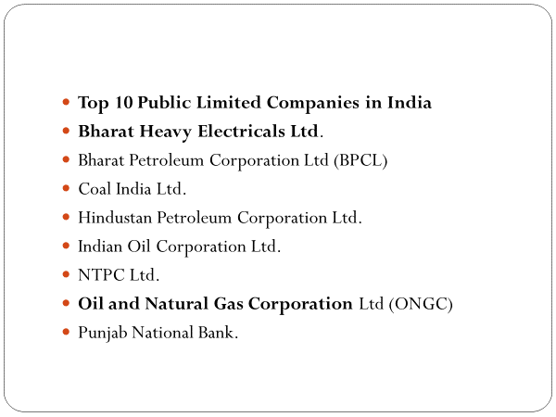

Slide 25
Top 10 Private Limited Companies in India
Bharti Infratel Ltd.
HDFC Bank Ltd.
ICICI Bank Ltd.
Infosys Ltd.
Hindustan Unilever Ltd.
ITC Ltd.
Larsen & Toubro Ltd.

Slide 26
Age limit of Directors in case of private company is ___________ years.
(a) 65 (b) 70 (c) 75 (d) No limit

Slide 27
What is the tenure of director of Central Bureau of Investigation?
(a) 5 years
(b) 4 years
(c) 3 years
(d) 2 years

Slide 28
Answer: b

Slide 29
Which of the following branch does not belong to the CBI?
(a) Anti Corruption Branch
(b) Economic Offense Branch
(c) Forensic Science
(d) Meteorology Branch

Slide 30
Answer: d

Slide 31
) Minimum number of members to form a private company is
a. 2
b. 3
c. 5
d. 7

Slide 32
Answer: (a) 2

Slide 33
A proposed name of Company is considered undesirable if
(a) It is identical with the name of an existing company
(b) It resembles closely with the name of an existing company
(c) It is an emblem of Government of India, United Nations etc.
(d) In case of any of the above

Slide 34
Answer- D

Slide 35
A person cannot hold directorship in more than ____ public companies
(a) 3
(b) 10
(c) 20
(d) 7

Slide 36
(c) 20

Slide 37
A private company means a company which has a minimum paid up capital of Rs.————-
(a) 1,00,000
(b) 5,00,000
(c) 50,00,000
(d) none of the above

Slide 38
(a) 1,00,000

Slide 39
We wish to be good citizens of every community in which we operate." This is
A.Ethical Code
B.Political and Social Code
C.Legal Rule
D.Legal Act

Slide 40
A

Slide 41
Which below mentioned statement is considered as ethical statement
• Lying to your spouse about how much money you spent.
• Lying to your parents about where you were for the evening.
• Stealing money from the petty cash drawer at work.
• To avoid conflict of Interest

Slide 42
D

Slide 43
Which below mentioned statement is considered as ethical statement
• Lying on your resume in order to get a job.
• Talking about a friend behind his back.
• Taking credit for work you did not do.
• To improve the understanding of technology, its appropriate application, and potential consequences.

Slide 44
D

Slide 45
What Brings Women to Engineering?
 Good academic performance
 Good long-term job prospects
 Diverse job options after graduation
 All of the Above

Slide 46
D

